Slide 1

Graded Project on SQL
Created by –Ajin K. Biju

Slide 2
Visualize the yearly approval trends of drugs

Slide 3
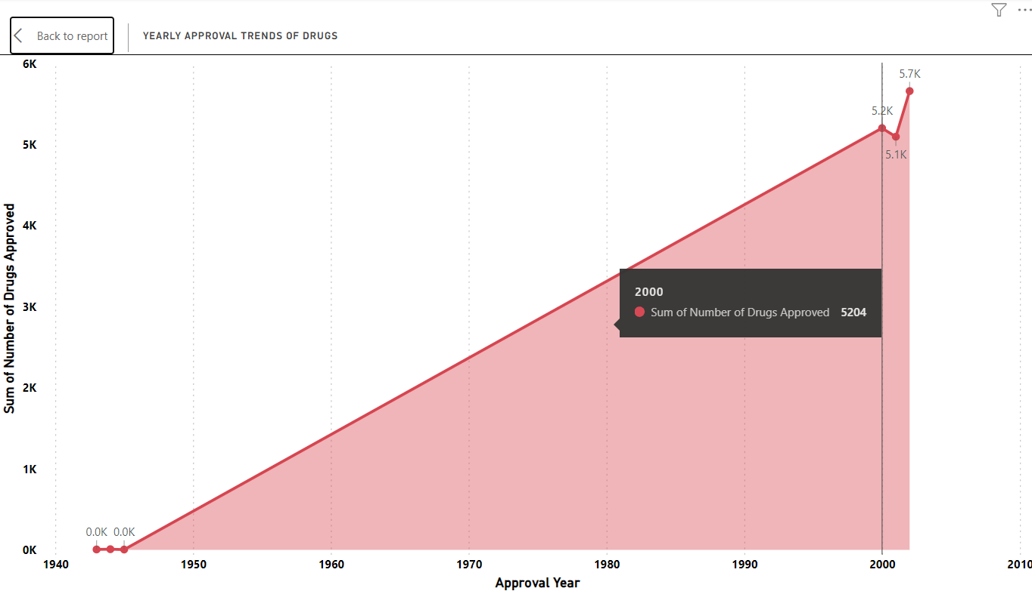
Analysis
Approval Year | Number of Drugs Approved
2002 | 5661
2000 | 5204
2001 | 5098
1945 | 5
1943 | 6
1944 | 9

Slide 4
Approval trends over the years based on different sponsors

Slide 5
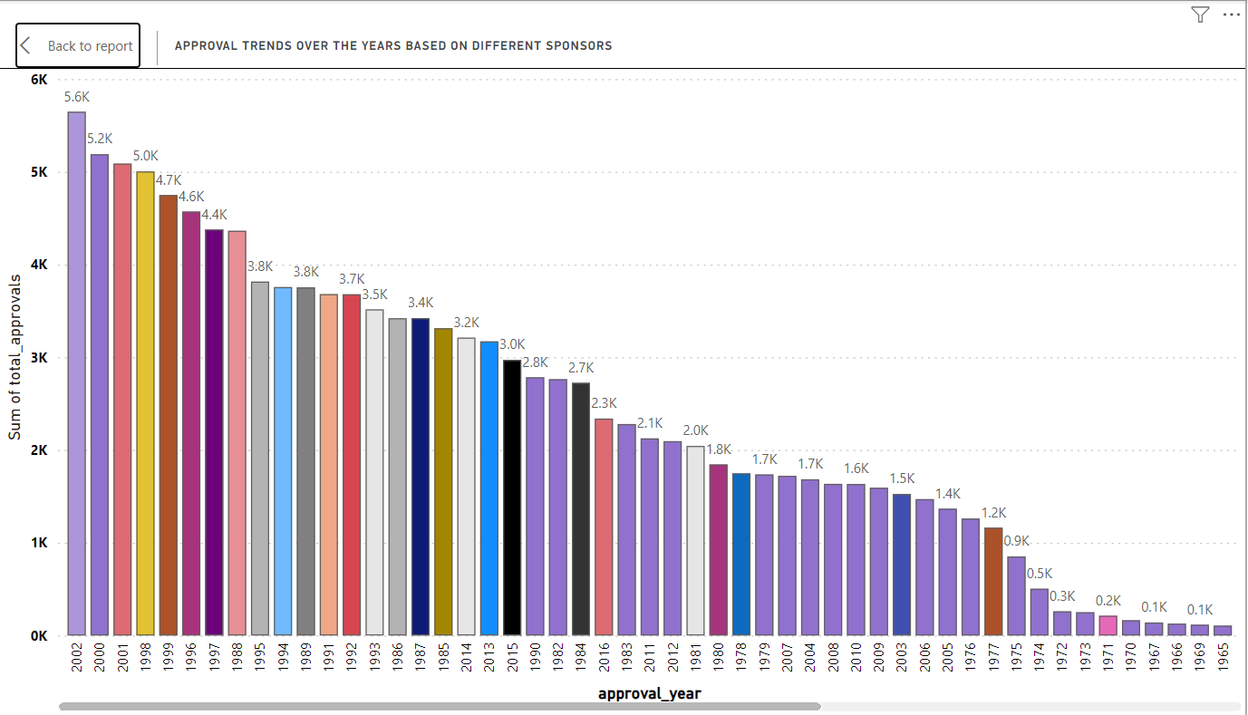
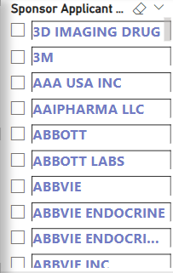

Slide 6
Segmentation of products based on Marketing Status

Slide 7
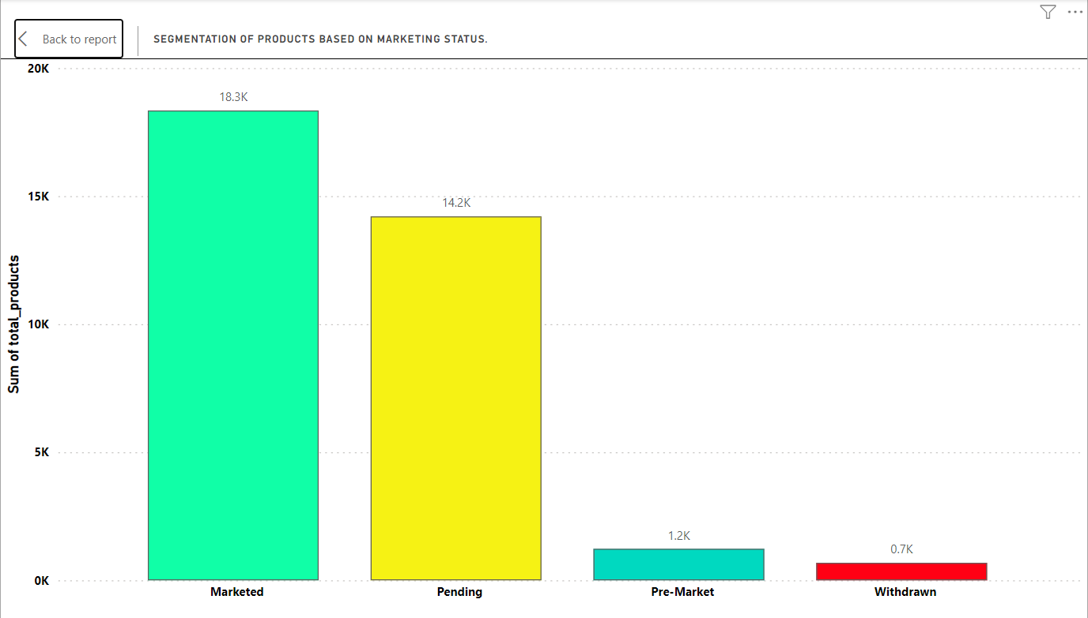
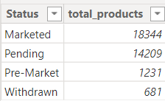

Slide 8
Total number of applications for each Marketing Status

Slide 9
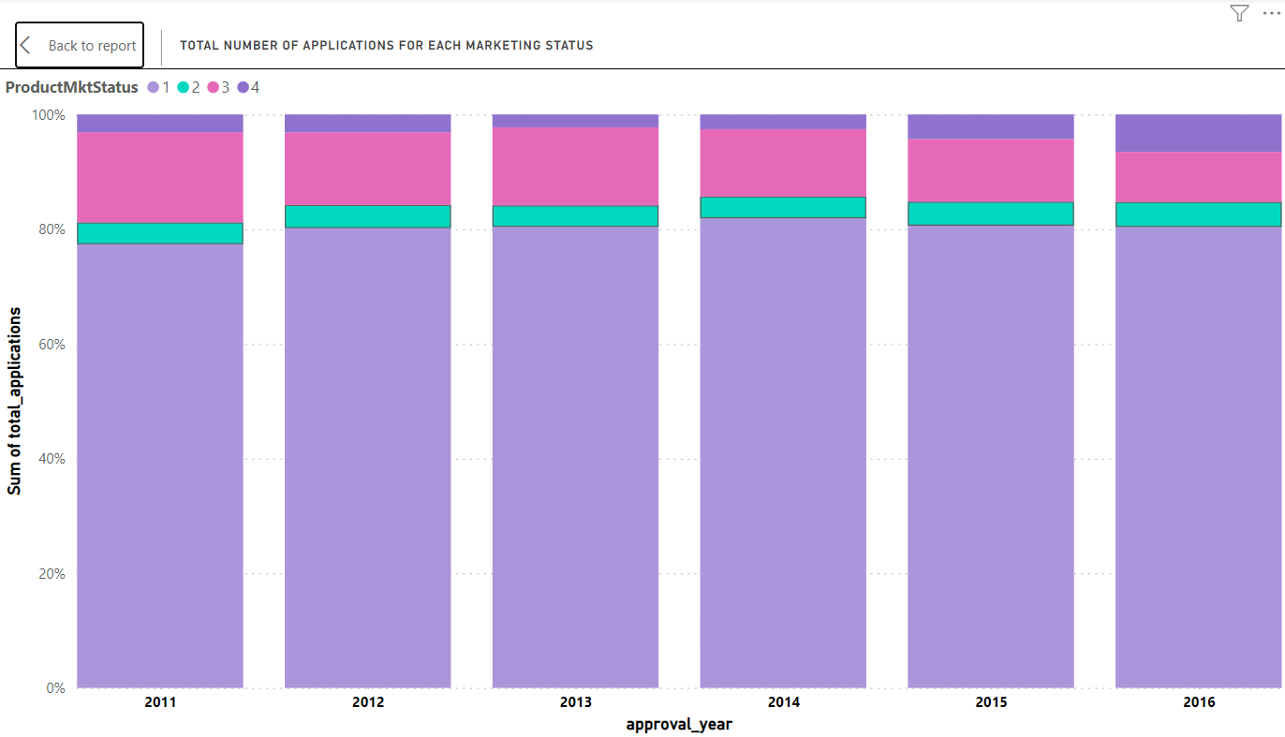

Slide 10
Analyze the grouping of drugs by dosage form

Slide 11
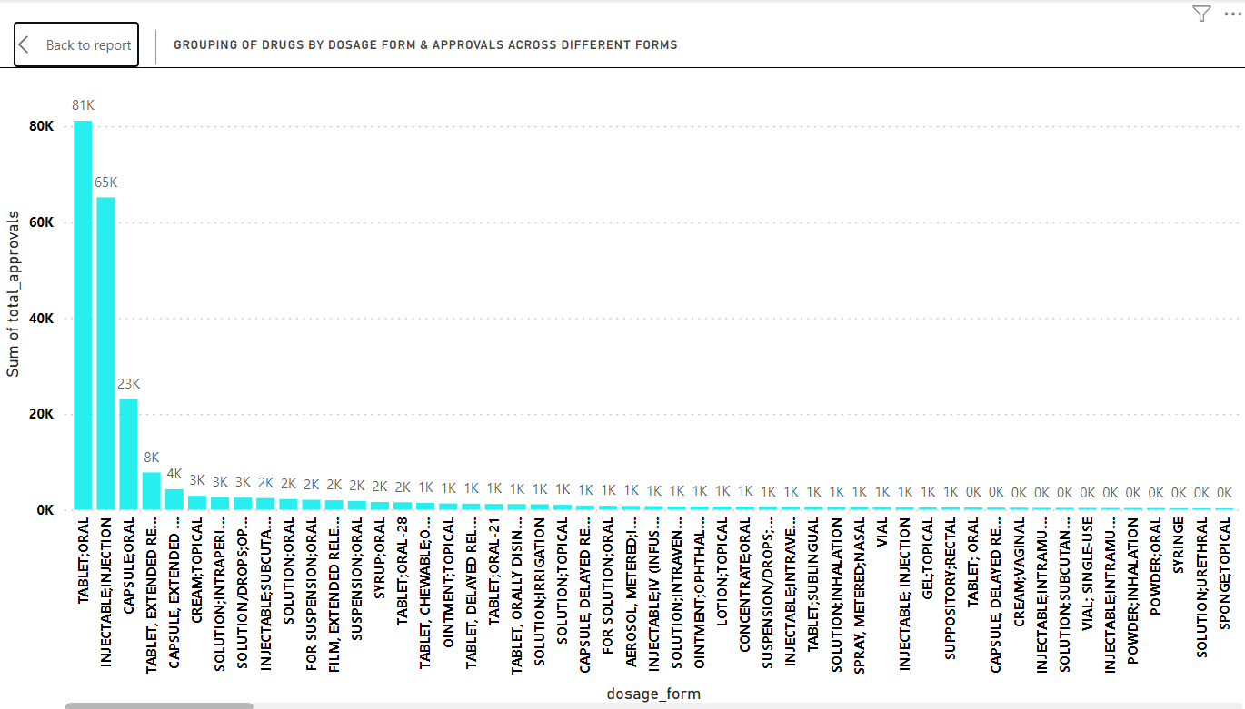
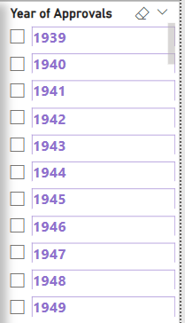

Slide 12
Visualize drug approvals based on therapeutic classes

Slide 13
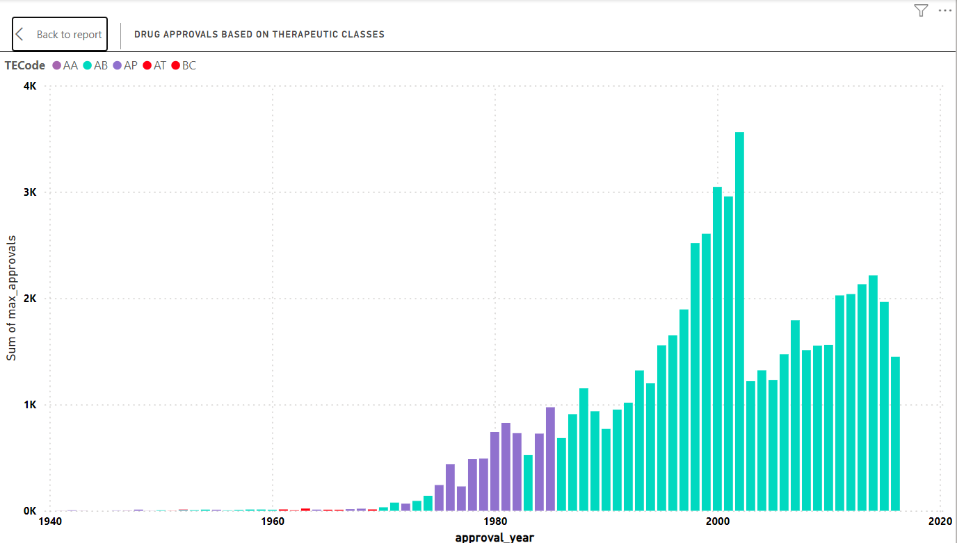

Slide 14
Thank you

